Slide 1
Design of Micro/Nano Sensors Report
Piezoresistive Sensor Based on High Performance Flexible Pressure Sensitive Film Material
11911736 冯硕
11910603张睿贤
11911007周宇轩
11910609张弼弘

Slide 2
Introduction
OUTLINE
Traditional mechanical pressure sensors are
(a) rigid materials such as metal conductors or semiconductors
(b) the flexible pressure sensor made of polymer piezoelectric material and conductive polymer composite materials

Slide 3
目录
CATALOGUE
Background and Current Research Results
Theoretical analysis and material
Simulation: Mirostructure Comparation
The Prosperities and Applications

Slide 4
1
Background and Current
Research Results

Slide 5
Classification of Flexible
Pressure Sensors
Three common transduction mechanisms
piezoresistivity
capacitance
piezoelectricity
Schematic illustration of three common transduction mechanisms and representative devices:(a) piezoresistivity; (b) capacitance; and (c) piezoelectricity.

Slide 6
Conductive Polymer Composites
elastic composite material with a pressure-sensitive effect formed by uniformly dispersing the conductive particles in the insulating polymer composites
炭黑、碳纳米管、石墨烯等分散在硅胶(PDMS)、环氧树脂
Current Research Results
Material/structure type I

Slide 7
Current Research Results
Material/structure type II
Sensitive Layer Surface Micro-structure
periodic surface micro-structures, the contact resistance, generated between electrodes or micro-structures, is also a way to prepare excellent flexible piezoresistance sensors.
PDMS materials have excellent elasticity, chemical stability, biophase and plasticity.
OFET (Organic field-effect transistor)
the schematic representation of an OFET-type flexible pressure sensor made from a PDMS film with an inverted pyramid-type microstructure.

Slide 8
Current Research Results
Material/structure type III
Sponge Foam Structure and Carbon Skeleton
MAKE polymer material into sponge foam structure or carbon skeleton has become an important sensitive material of new flexible piezoresistive sensor
Melamine
(a) Schematic diagram of carbonization of melamine sponge and preparation of flexible pressure sensors; (b) Schematic diagram of carbonized melamine sponge packed in PDMS matrix to make friction generator and adsorbed CNT to make flexible pressure sensor

Slide 9
Electrical-Conductive Fabric and Paper
Inspired by flexible pressure sensors as wearable sensors, conductive fabric and conductive paper have also become a choice of new sensor-sensitive materials.
Gold nanowires/cotton paper fiber sensor in pulse measurement and non-contact sound measurement
Current Research Results
Material/structure type IV

Slide 10
2
Theoretical analysis and material

Slide 11
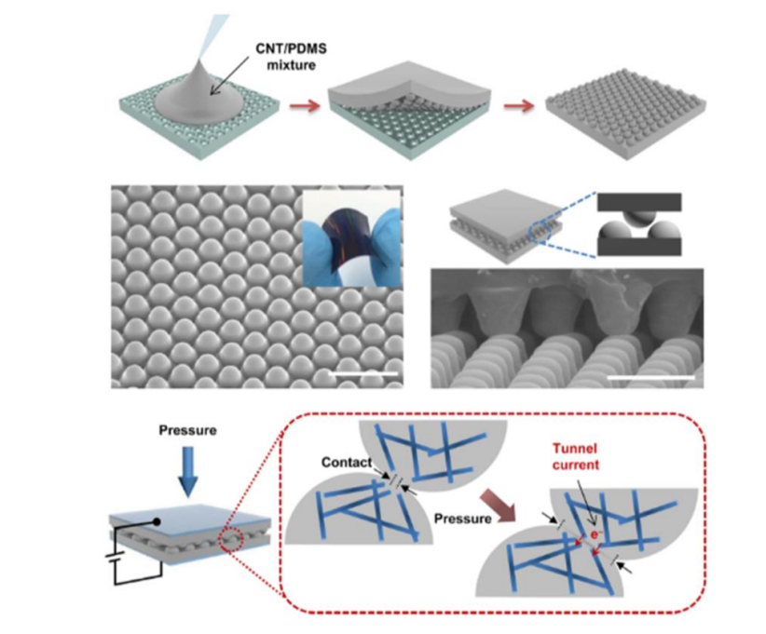
The structure of surface microstructure
Two important property
Hemispherical microstructure
CNT/PDMS
Preparation method, surface morphology and sensitive mechanism

Slide 12
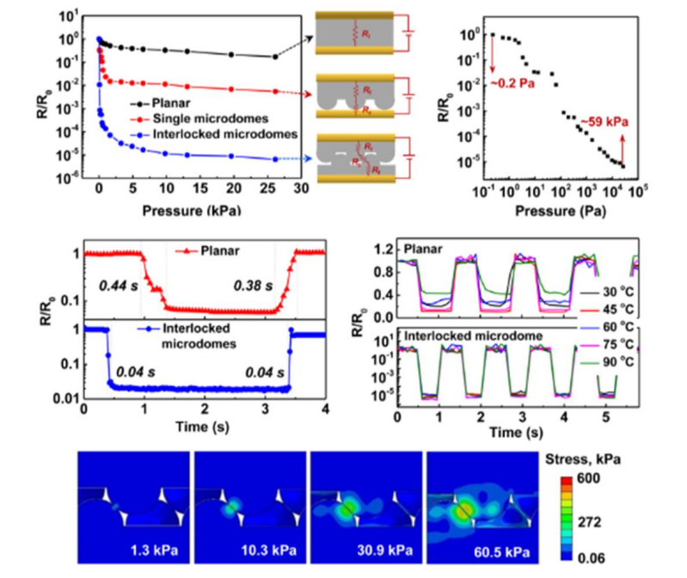
Pressure
The finite element analysis shows that the deformation of the sensitive membrane is basically concentrated on the microstructure under the pressure of 60.5kpa
Gold nanowires/cotton paper fiber sensor in pulse measurement and non-contact sound measurement
two-sided, single-sided
and no microstructures

Slide 13
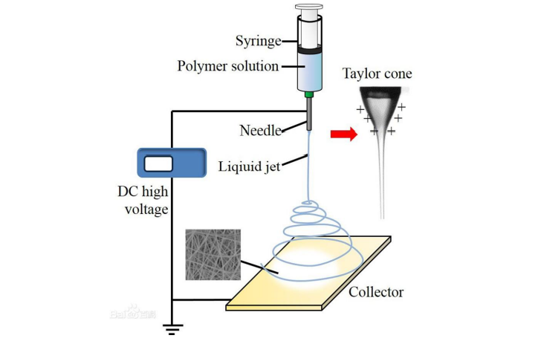
Selection of the preparation process
Screen printing process
Better pattern accuracy and film thickness
Electrospinning method
high-performance sizing agent and good
pattern accuracy and film thickness

Slide 14
Selection of the conductive filler
Carbon nanotubes
Easy to entangle and agglomeration, but not easy to disperse
Graphene
Excellent electrical conductivity and mechanical properties.
the conductive material is also prone to crimp and agglomeration in the polymer matrix material
carbon black
High conductivity, easy dispersion and low cost

Slide 15
3
Simulation: Mirostructure Comparation

Slide 16
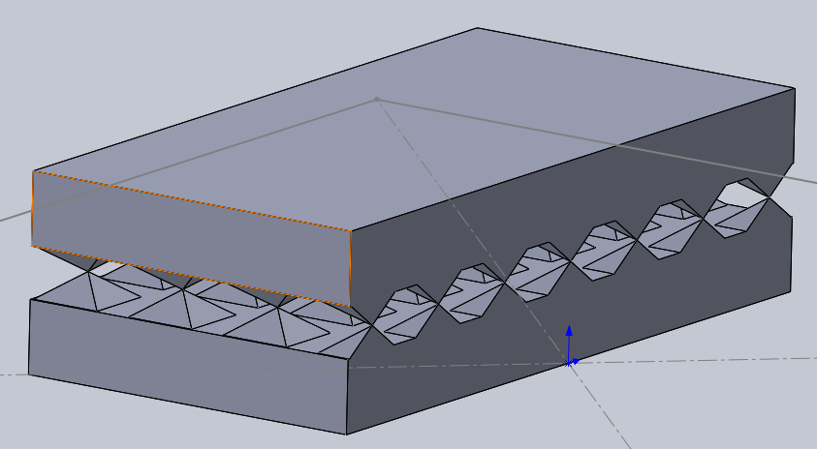
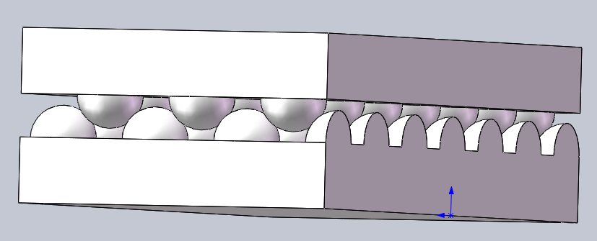
Preparation
Three Mirostructure: 10um*10um, the same intervel
Single pyramid
Double pyramid
Double sphere
Materials: PDMS
Parametric scan F(load): 0~1000Pa (low pressure)

Slide 17
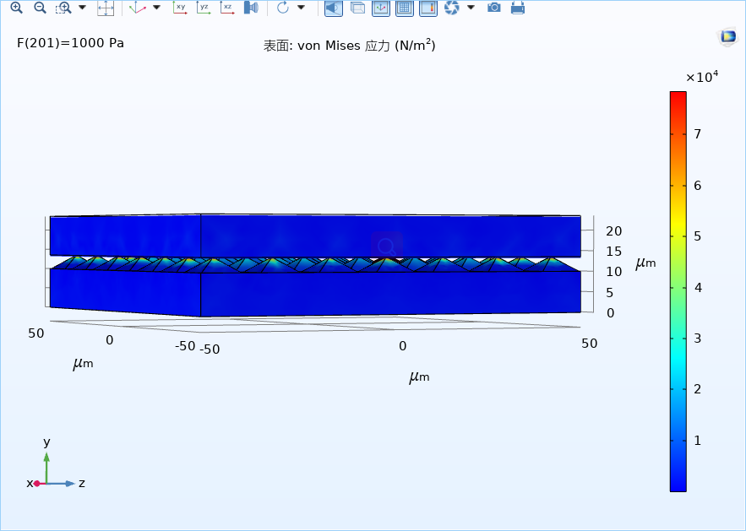
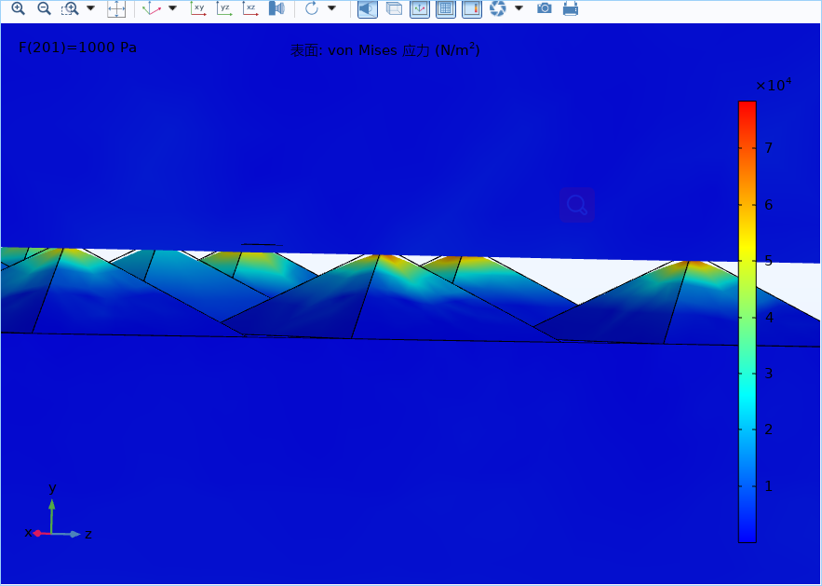
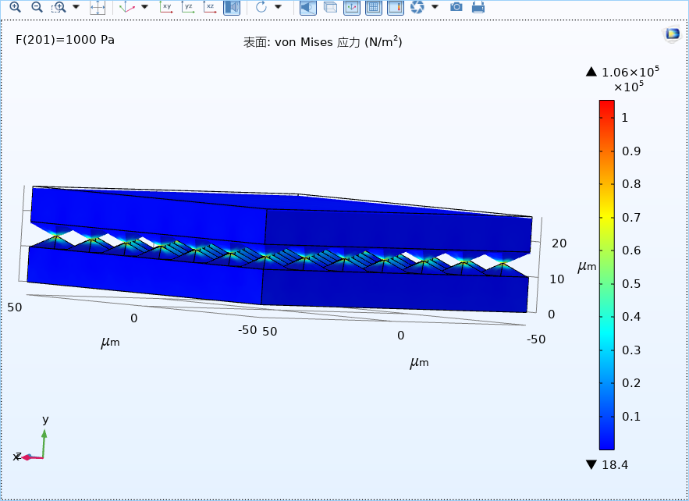
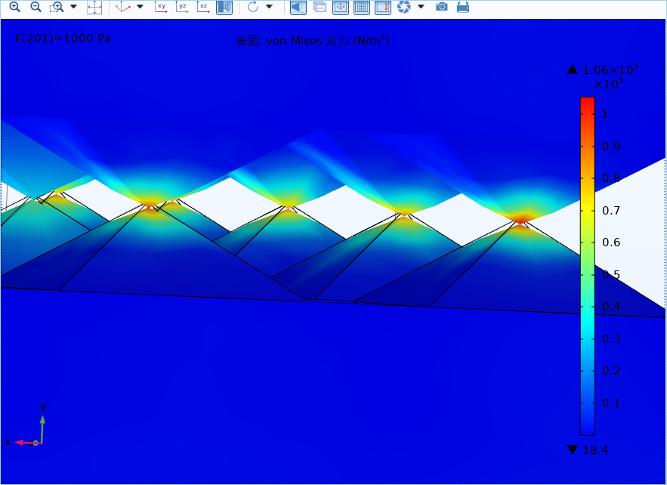
Calculation

Slide 18
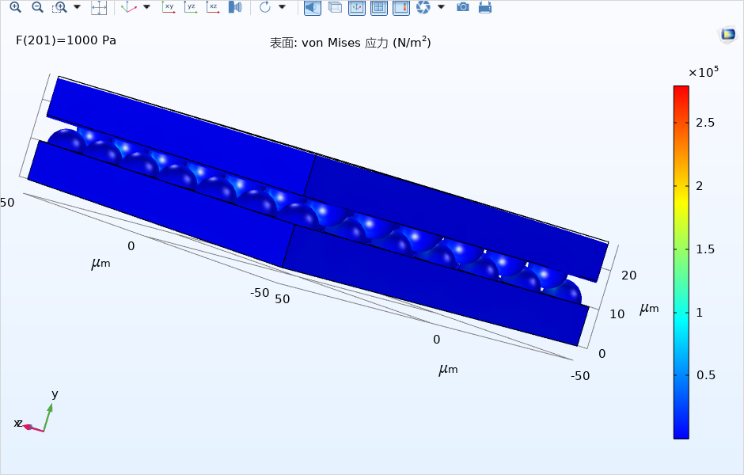
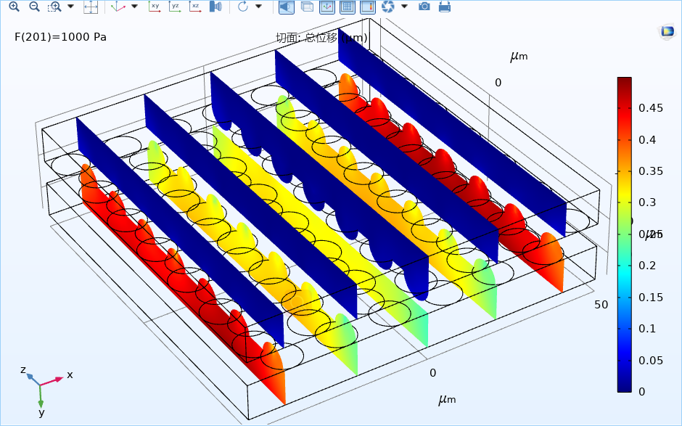
Calculation

Slide 19
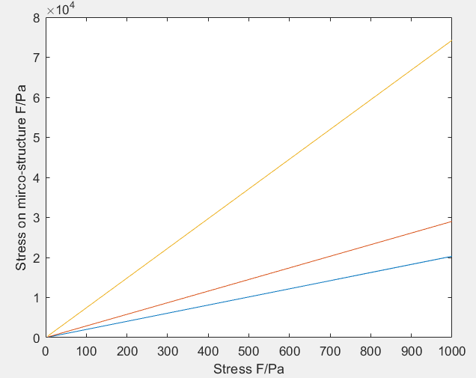
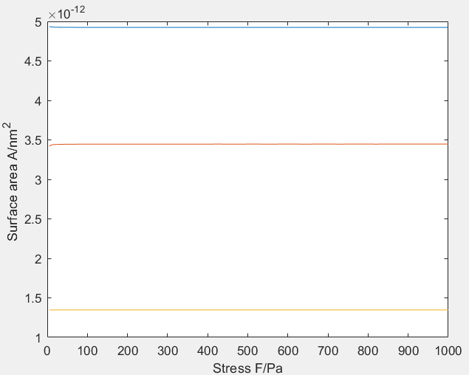
Data post-processing
? ? ?
结构+网格？
材料设置？
计算方式？

Slide 20
4
The Prosperities and Applications

Slide 21
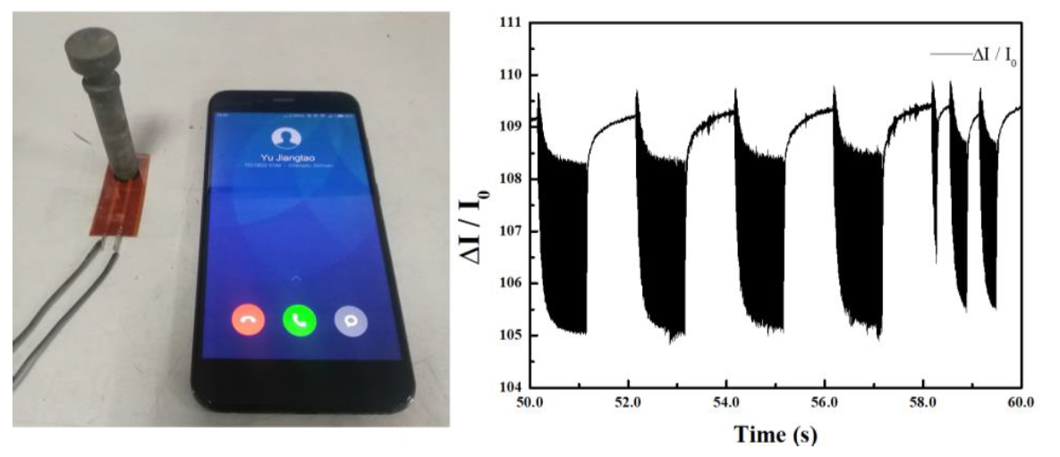
Vibration Detect in the Environment
The equipment performance detect system
Detect equipment vibration states
The smart home system
Detect electronics vibration.
Vibration trigger action

Slide 22
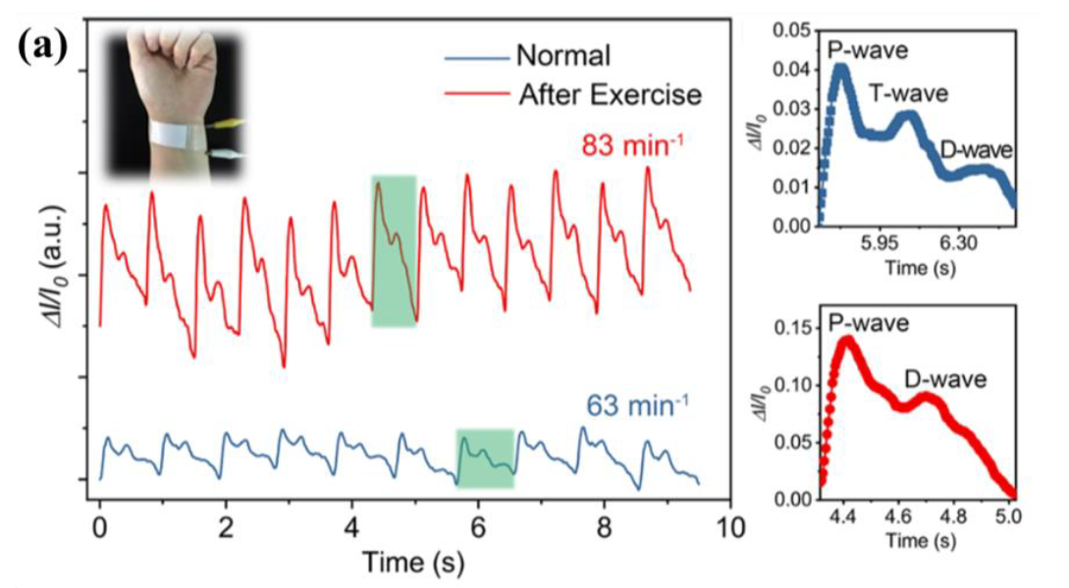
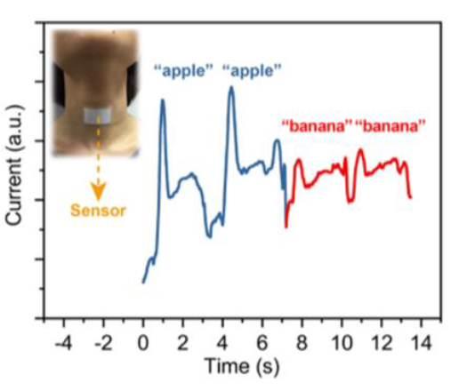
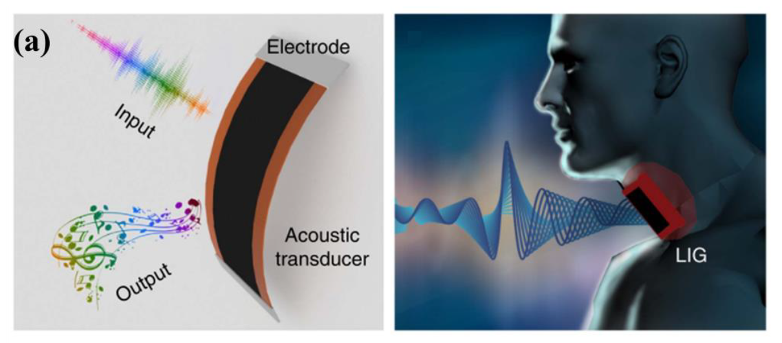
Vibration Detect in the Wearable Device
Heartbeat Detect
Pulse detect
Voice Detect
Distinguish words
Artificial throat

Slide 23
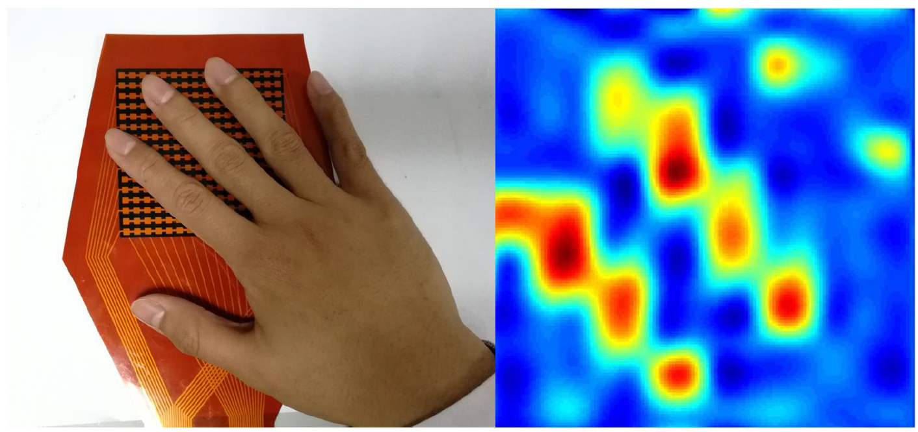
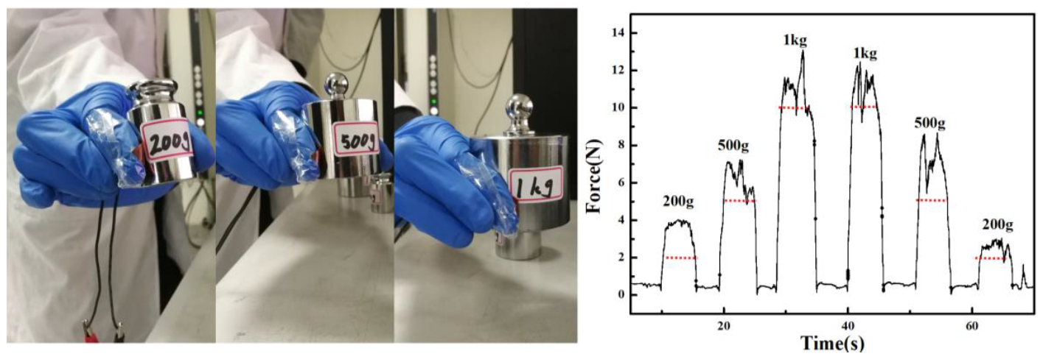
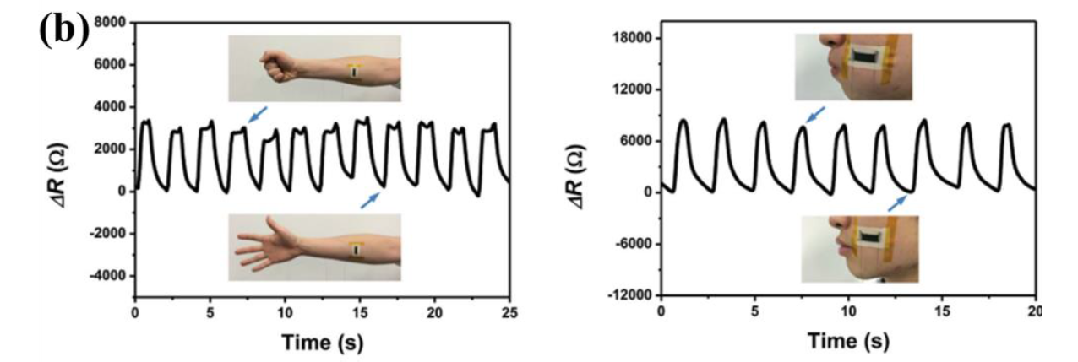
Electronic Skin
Force detect
Touch perception
Clamp force detect
Deformation detect
Temperature detect
Detect electronics vibration

Slide 24
Thanks for your patients!

